Slide 1
Sticky Notes
Web App Demo with Javascript, ASP.NET MVC and Entity Framework

Slide 2
Prerequisites
Visual Studio 2017 Community Edition
Entity Framework NuGet package

Slide 3
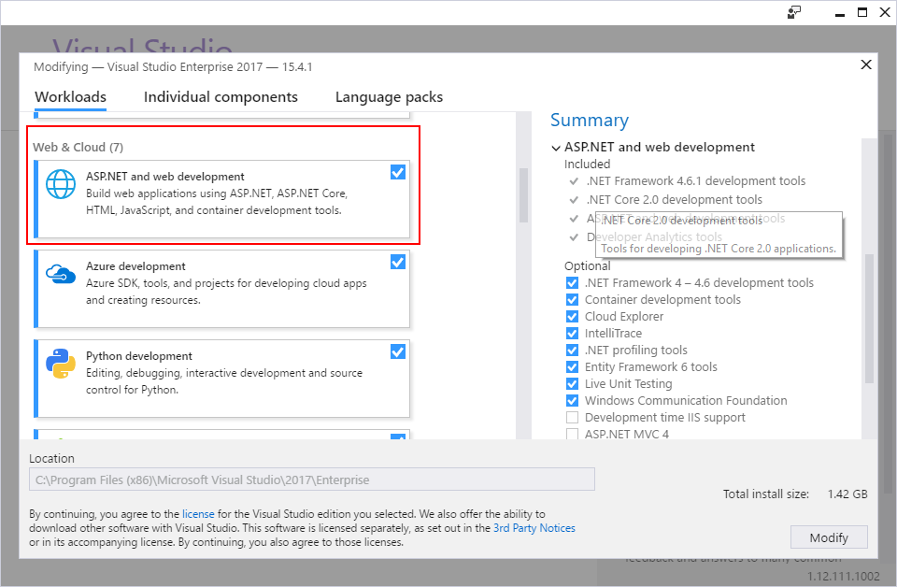
Visual Studio 2017 Community Edition
Free, fully-featured IDE for students, open-source and individual devs
Download from: https://www.visualstudio.com/downloads/
Be sure to check “ASP.NET and web development” when installing VS

